Slide 1
What is designing about?
Chapter 1

Slide 2
When is design needed?
In our everyday lives we are surrounded by things that have been designed.
The chairs we sit upon, the cars we drive, the phones we use to communicate with others, the houses/ﬂats that we live in.
These are all examples of artifacts, things that have been created through some form of human activity.
All of these have also been created to meet some form of human need and hence can be considered as providing a solution to some form of ‘problem’.

Slide 3
Types of Problem
In the (relatively) early days of computing, Herb Simon recognized that computers could be used to help address two distinct types of problem.
• Well-Structured Problems or WSPs. These are distinguished by having a ‘right’ solution, and some clear tests that help demonstrate that this has been found.
For example, to ﬁnd the roots of the quadratic equation x2 − 5x + 6 = 0, we can either use inspection or the standard formula to determine that their values are x = 2 and x = 3. Putting either value back into the original expression provides a simple and complete test of correctness for that solution. Applications such as ﬁnancial modelling and database transactions provide examples of using computers to address WSPs.

Slide 4
Types of Problem
• Ill-Structured Problems or ISPs. For such problems there will usually be no explicit formulation, and many possible solutions, with these being characterised by being good or bad rather than right or wrong.
For ISPs there will be no deﬁnitive test to determine the correctness of a result, and so no way of knowing that the ‘best’ available solution has been achieved (usually termed ‘no stopping rule’). Computer applications such as face or voice recognition, that have to cope with incomplete information, can be considered as addressing ISPs.

Slide 5
Types of Problem
When we look at problem-solving more broadly, not just through the use of computers, these distinctions are every bit as useful. Many problems en-countered in science, particularly in physics and maths, are well-structured problems that can be solved through mathematical analysis.
However, the problems addressed by engineers, including software engineers, are nearly always ill-structured problems. The need for a bridge can be met in many ways, and there are many ways of writing even a simple computer program.
So addressing an ISP involves employing some form of design process which enables us to formulate a possible solution and then evaluate how well it might meet a particular need.

Slide 6
The CCC system as an ISP
Let’s consider a design scenario that might occur when the software design team start to plan how they will develop the software for CCC.
1. The head designer suggests representing each car as an object, with its current status being stored internally, and a set of methods that allow customers and other users (such as the maintenance team and the accounting software) to access that status.
2. The next question is how to organise all of these objects. So a member of the team suggests using an array of objects. One consequence is that every car now has to have an index number so that the relevant object can be accessed.
3. And then there’s the question of how to model the status of a car internally (is it available, unavailable or reserved?).
None of these decisions exists in isolation, and each one has implications for the way that the design will evolve.

Slide 7
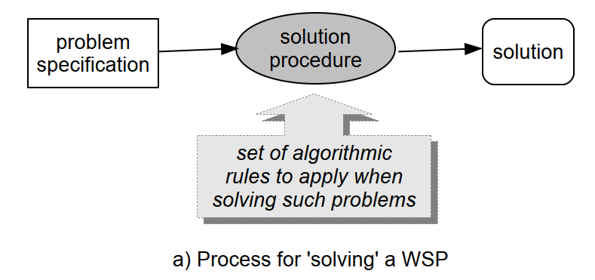
Process for 'solving' a WSP
Figure provides a simple schematic illustration of the diﬀerent ways in which we need to approach the task of ‘solving’ ISPs and WSPs. A really important distinction is the way that postulating a possible solution to one aspect of an ISP may inﬂuence our understanding of that aspect as well as interacting with the ideas we may have for solving its other aspects (indicated by the dashed-line backward pointing arrows).

Slide 8
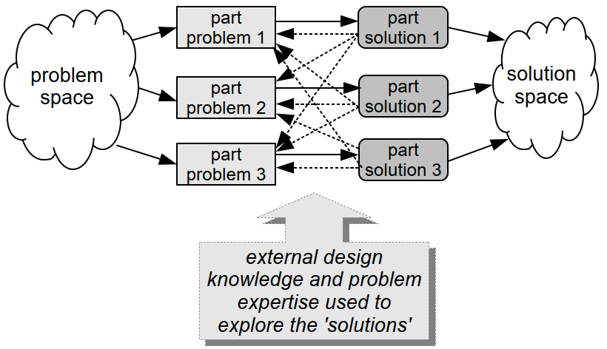
Process for 'solving' an ISP

Slide 9
What exactly do we mean by design?
One of the complications of the English language is that a word can have multiple uses, and we may often have to work out which meaning is intended by considering the context in which the word appears. The word design is just such a word, and in this book we are going to be concerned with exploring a range of key concepts and ideas related to each of its meanings. So it is appropriate to begin by examining just what these meanings are.
Firstly, we can speak of ‘a design’, using it as a noun that describes something that forms a plan of how we intend some artifact to be constructed.

Slide 10
What exactly do we mean by design?
Indeed, we often speak of a ‘design plan’ in this context, where the purpose of this is to provide a ‘model’ of how some form of ‘product’ should be constructed. This particular meaning is therefore widely associated with the idea of manufacturing something, whether crafted by an individual, or assembled in a factory (mass production)1. So, we may have a design plan that provides guidance on how to construct a model boat (or a real one, depending on how ambitious we are), or an item of clothing, or a car.
The information provided in the plan about how to realise that design might be quite detailed and need to be followed exactly, which is probably a good idea when building a boat or a kit car, or it might be something of a more strategic nature that we are expected to interpret and adapt, which would be more appropriate when making a garment to ﬁt our own ﬁgure.

Slide 11
What exactly do we mean by design?
However, rather than a physical artifact the design plan may describe some form of procedure or process that is to be performed in some way.
Again, there are many forms this can take—we can regard a musical score as being a plan for a particular form of process, that is to be followed by the player or players. Again, it may be very detailed, or leave scope for improvisation.
Other examples of such procedures might be concerned with form-ﬁlling, such as applying on-line for a driving licence or a passport, describing the various things we need to do, and possibly in what order. And of course, we can consider a recipe for making a cake as being a plan that describes a process, but also one that a competent cook will be expected to adapt quite freely.

Slide 12
What exactly do we mean by design?
The two forms of plan can also be combined. As an example, the design for a bicycle may describe both the structure of the bike and also specify the way in which it should be assembled in order to ensure that its physical characteristics are not compromised.
An important characteristic of the use of the word ‘design’ in this way is that we usually associate it with some form(s) of description for the plan. And of course, there are many forms of description, which may employ words, pictures, mathematical forms, musical notation, etc. as well as combinations of these. (Few diagrams are very meaningful without some accompanying text, as anyone who has tried to assemble ﬂat-pack furniture will be only too aware.)

Slide 13
What exactly do we mean by design?
The second meaning, which is closely related to the ﬁrst one, and probably even more important to us here, is when we use the word design as a verb, as in ‘to design’. This is concerned with the process of designing something—with the goal being to produce a plan.
The activity of designing something forms the most creative (and usually challenging) aspect of design as a concept, and indeed, and with the diﬀerent processes employed for designing software.
While design plans may vary in terms of how exactly they need to be followed, there is usually a degree of formality associated with their structure that is required to make them understandable. In contrast, design processes tend to be much less constrained, and even following a recommended practice invariably requires some interpretation and adaptation. So we can interpret design thinking as meaning thinking about how to design something.

Slide 14
Conclusion
Ill-Structured Problems (ISPs) are characterised by a lack of true/false properties—and are the type of problem that needs to be ‘solved’ through the use of design rather than analysis. (And software development is deﬁnitely an example of an ISP.)
Technical debt is a concept that distinguishes software development that is undertaken ‘for real’ from software that is written as a learning exercise and then discarded. Designers need to think about the consequences of their decisions in terms of their eﬀect upon the future evolution of an application.

Slide 15
Conclusion
Design can be used as a noun. Employed in this way, ‘a design’ means a plan for how some goal is to be achieved, whether this be physical (how to construct something) or a process (how to perform something).
Design can be used as a verb. This refers to the act of designing (producing a plan).
There are diﬀerent perspectives upon design. Design thinking applies to a range of activities that can all be considered as being design in some form. Three major perspectives on design that are all relevant to software development are design as styling, design as planning and design as adaptation (experience and models).

Slide 16
Conclusion
Designing is creative. When undertaking design activities, our objective is to create something that does not already exist, which involves predicting an eﬀect upon the future that will only be realised if the design plan is feasible. To do so, we need to be able to envisage how something will be done, and then work backwards to devise ways of bringing this about.

